Slide 1
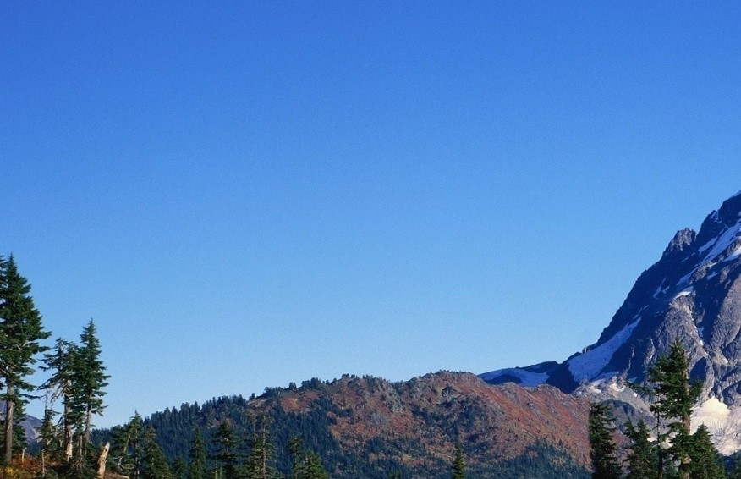
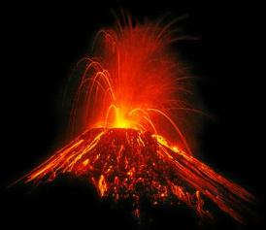
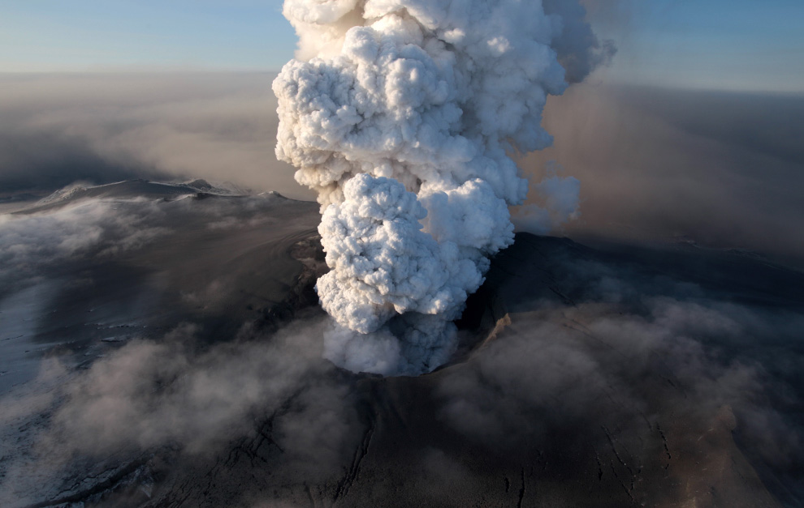
Volcanoes
Most volcanoes are located near plate boundaries.
Approximately 65% of all volcanoes are found along the ‘Ring of Fire’ surrounding the Pacific Ocean.
Subduction zones and mid-ocean ridges allow molten rock to reach the surface

Slide 2
Types of Molten Rock
Magma
It is found deep within the crust and upper mantle
Lava
It is found flowing from an erupting volcano
Essentially, lava is magma on the Earth’s surface.

Slide 3
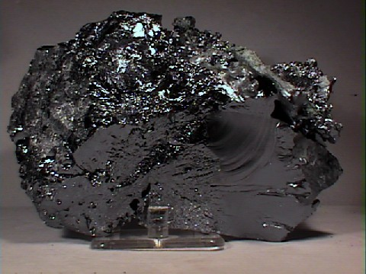
Magma
The most abundant elements in magma are silicon and oxygen; when combined it is referred to as silica.
Volcanic rocks are named based on the amount of silica present.
Types of volcanic rocks:
basalt, andesite, dacite, rhyolite
low silica high silica
Silicon

Slide 4
Viscosity
Magma also contains small amounts of gases (water vapour, carbon dioxide, sulphur dioxide).
Volcanoes have different shapes based on the chemistry and viscosity of their magma.
Viscosity: the resistance to flow
Magma viscosity is determined by silica content and temperature

Slide 5
Magma
Magma with high silica content:
Cooler, more viscous, more gases
Magma with low silica content:
Hotter, less viscous, fewer gases
Volcanoes with high silica magma produce the most explosive eruptions.
As magma approaches the surface, the pressure lowers allowing gases to bubble up and escape

Slide 6
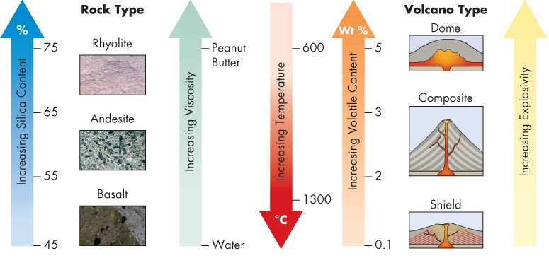
Magma
Rhyolitic and dacitic magmas produce explosive eruptions.
Basaltic and andesitic magmas produce non-explosive eruptions with lava that flows easily

Slide 7
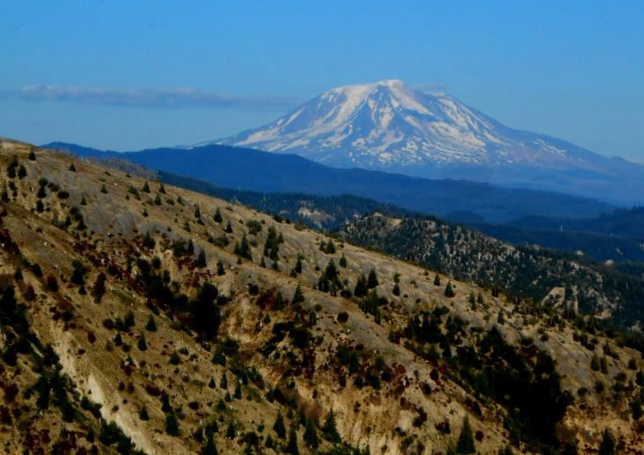
Types of Volcanoes
Volcanoes are classified into 4 types.
The classification is based on their shape, appearance, and eruption style.
Types of volcanoes:
- shield
- composite
- volcanic dome
- cinder dome
Mt. Adams

Slide 8
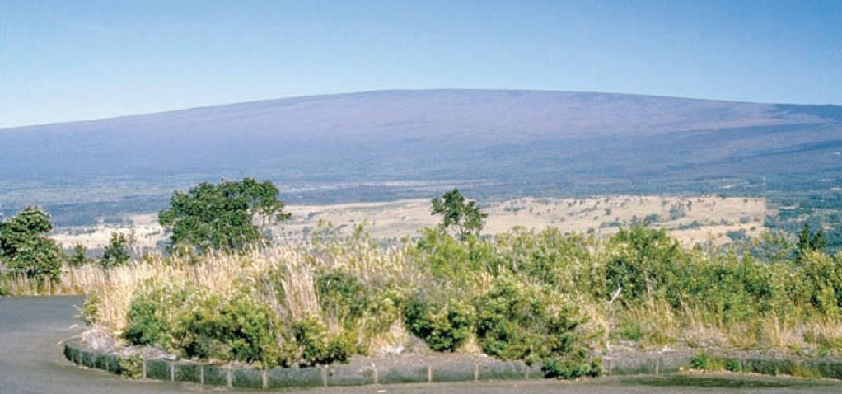
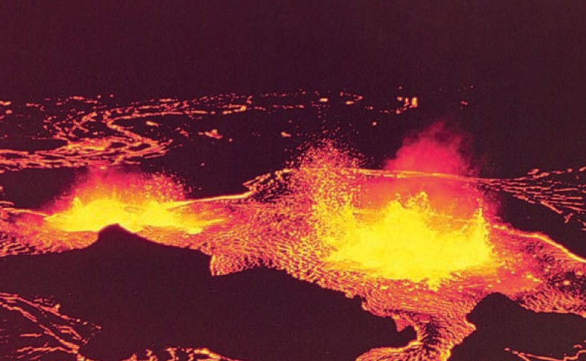
Shield Volcanoes
These are the largest volcanoes on Earth and are shaped as broad arcs (like warrior shields) built from lava.
They are associated with basaltic magma
Eruptions consist of well-flowing lava

Slide 9
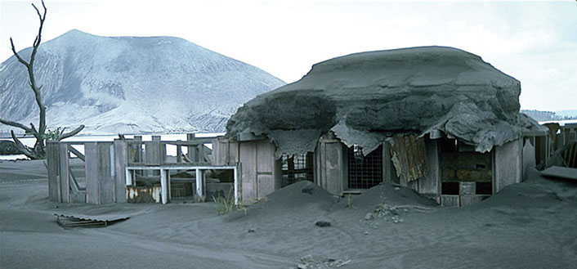
Shield Volcanoes
Some eruptions can
contain tephra.
Accumulations of tephra are referred to as pyroclastic deposits.
If compacted together, these deposits are called pyroclastic rock.
Tephra – fragmented material blown out during an eruption
These volcanoes are common in Hawaii, Iceland, and around the Indian Ocean

Slide 10
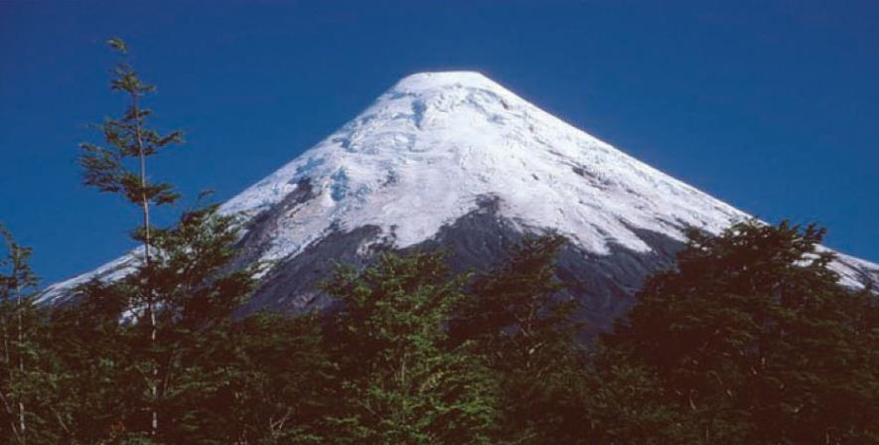
Composite Volcanoes
These volcanoes are cone-shaped and are built from a combination of lava flows and pyroclastic deposits.
Stratovolcanoes; this term comes from the stratified layers of lava and deposits

Slide 11
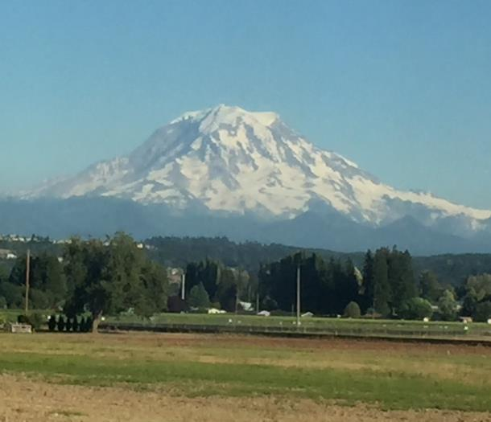
Composite Volcanoes
Eruptions are more dangerous and explosive but less frequent than shield volcanoes.
These volcanoes are common along the west coast form Alaska to Northern California
Mt. Rainier

Slide 12
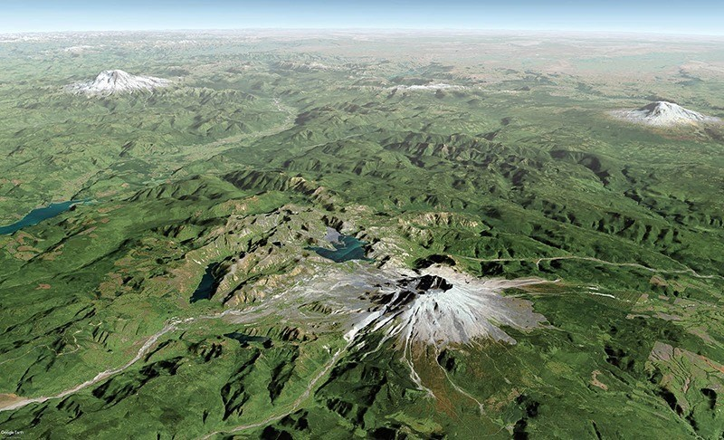
Composite Volcanoes
Mt. Rainier, Mt. St. Helens (both in Washington State) and Mt. Adams (in Oregon) are the most well-known composite volcanoes in North America.
Mt. Rainier
Mt. Adams
Mt. St. Helens

Slide 13
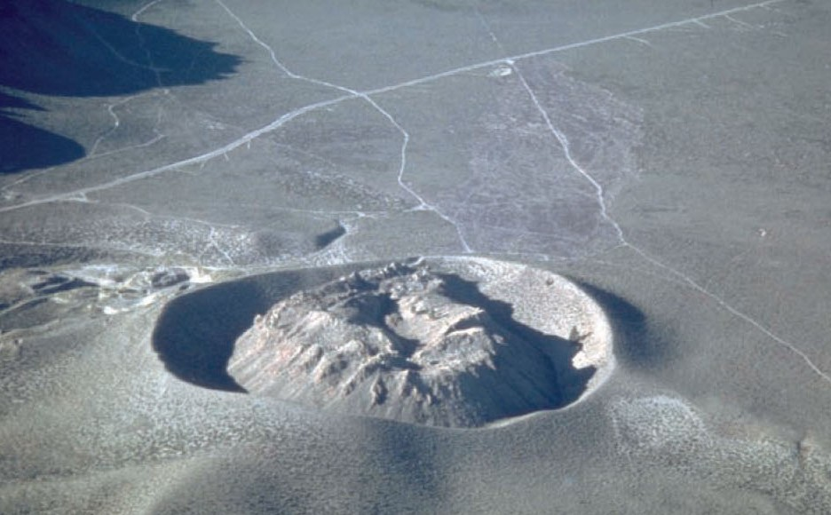
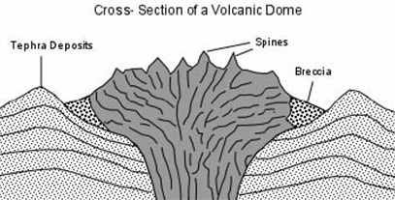
Volcanic Domes
These volcanoes contain highly viscous rhyolite magma.
They are steep sided mounds that form around vents

Slide 14
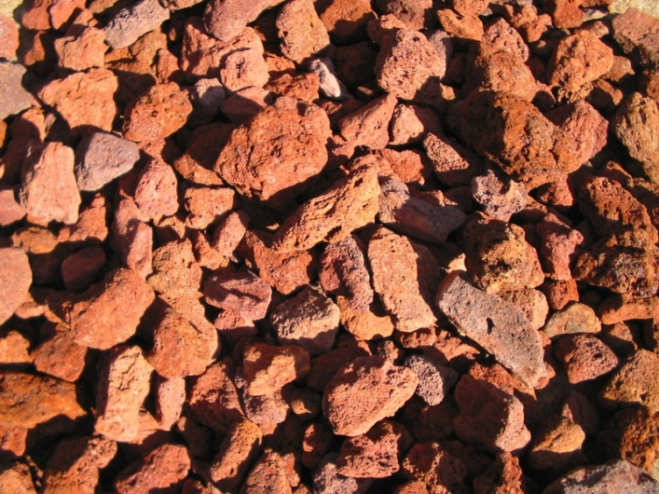
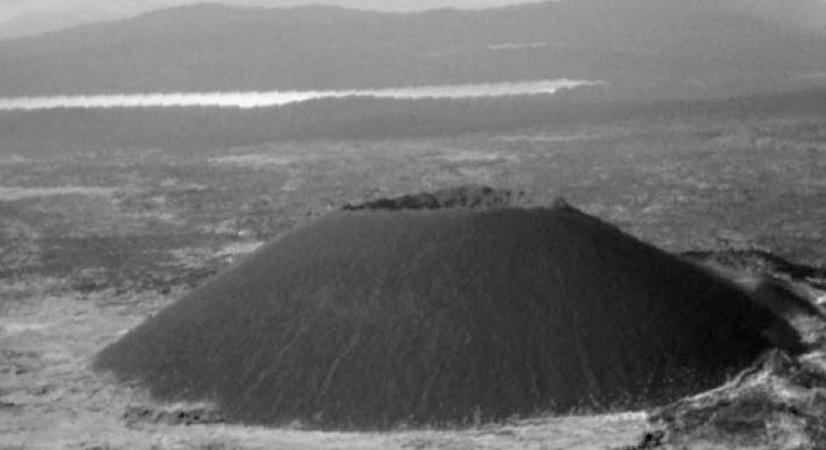
Cinder Cone Volcanoes
These are relatively small volcanoes composed of small forms of tephra.
They are round to oval shaped and typically contain a crater at the top
These volcanoes are found in Mexico

Slide 15
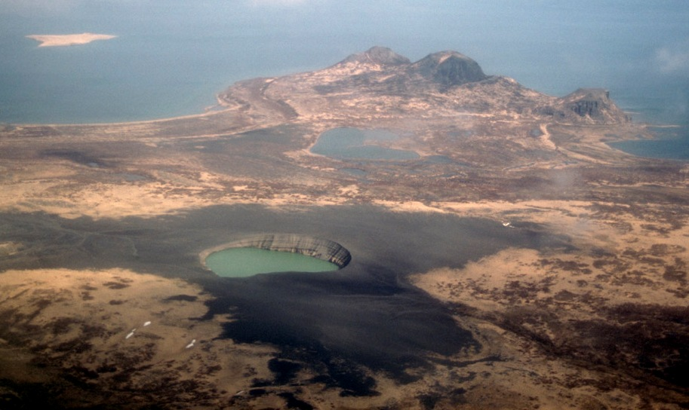
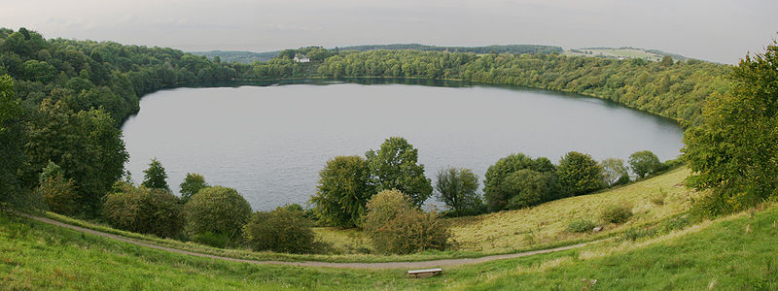
Maars
Definition:
A circular volcanic crater produced by an explosion and filled with water
They are caused by groundwater encountering magma, creating the explosion.
Maar derives from the Latin mare meaning sea and resembles a large lake

Slide 16
Ice-Contact Volcanoes
Some volcanoes erupt beneath or alongside glaciers.
These eruptions melt huge quantities of ice producing floods known as jokulhlaups
When lava contacts glaciers, it quickly cools to form pyroclastic rock.
Ice-contact volcanoes are found in Iceland and British Columbia

Slide 17
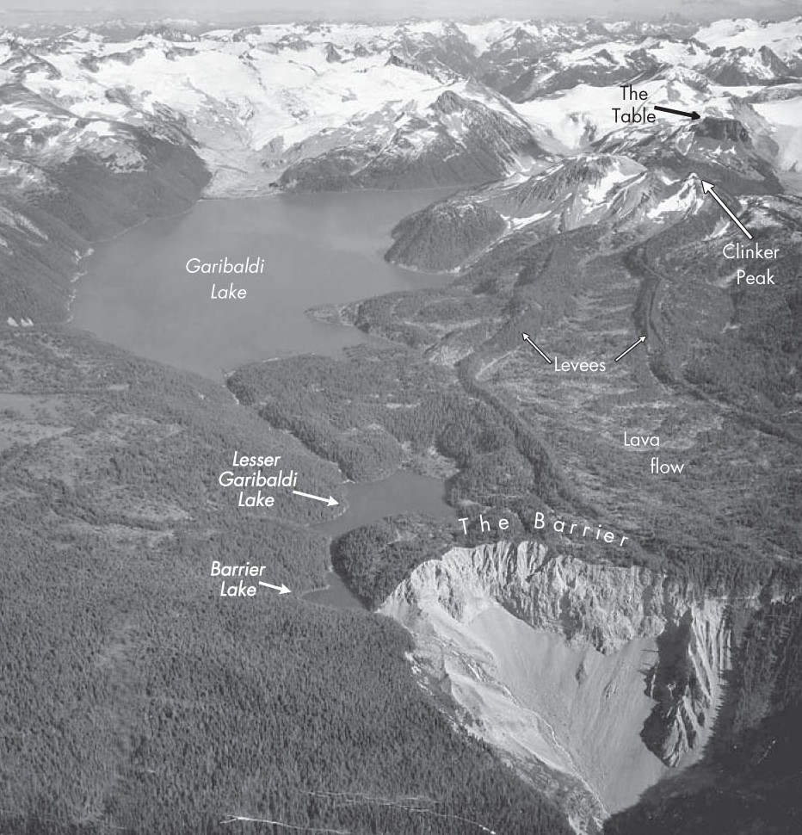
Ice-Contact Volcanoes
Evidence of the Mt. Garibaldi eruption 12,000 years ago in British Columbia is preserved in currently exposed rock.

Slide 18
Volcanic Features
Crater
A depression formed by the explosion of a volcano top. They can be up to 2 km in diameter.
Volcanic Vent
An opening on the surface through which lava and pyroclastic debris erupt
Most vents are circular, but some are elongated cracks called fissures.

Slide 19
Volcanic Features
Caldera
a circular to oval depression formed during the collapse of a volcano
They can be up to 25 km in diameter
Eruptions that form calderas are the largest and most deadly eruptions on Earth.

Slide 20
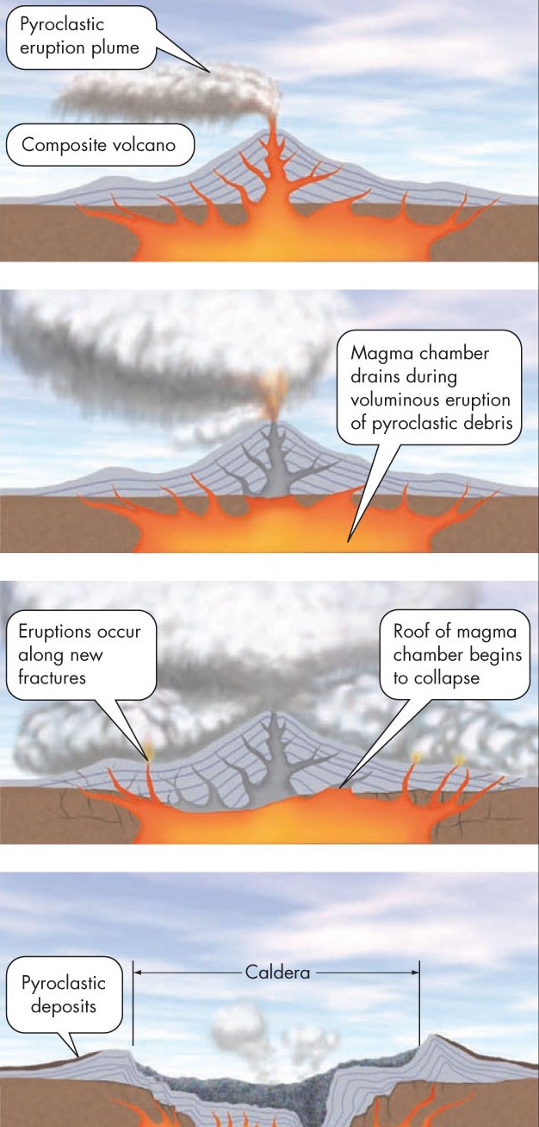
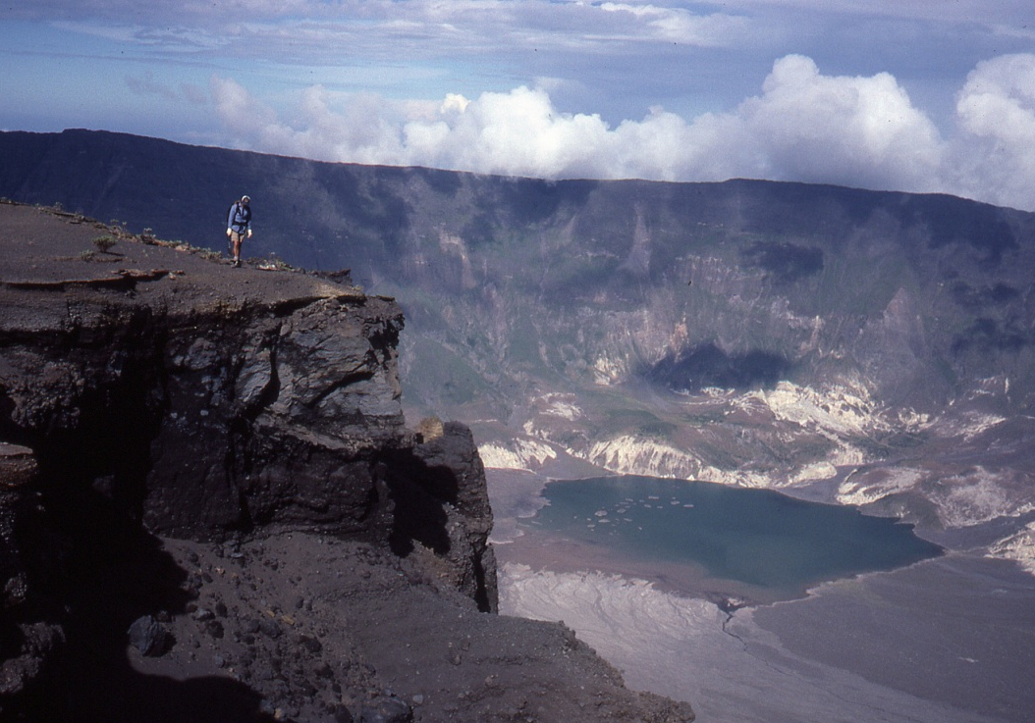
Formation of Calderas
Calderas are formed by the collapse of a magma chamber below a composite volcano during an explosive eruption.

Slide 21
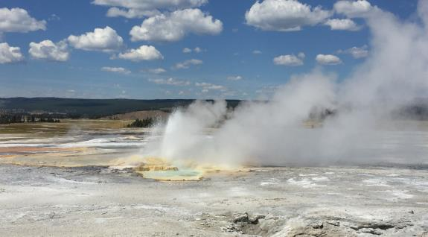
Hot Springs and Geysers
Heated groundwater can discharge at the surface as a hot spring.
Groundwater that boils in an underground chamber to periodically produce a release of steam or water is called a geyser.
There are approximately 1000 geysers on Earth and nearly half of them are in Yellowstone Park

Slide 22
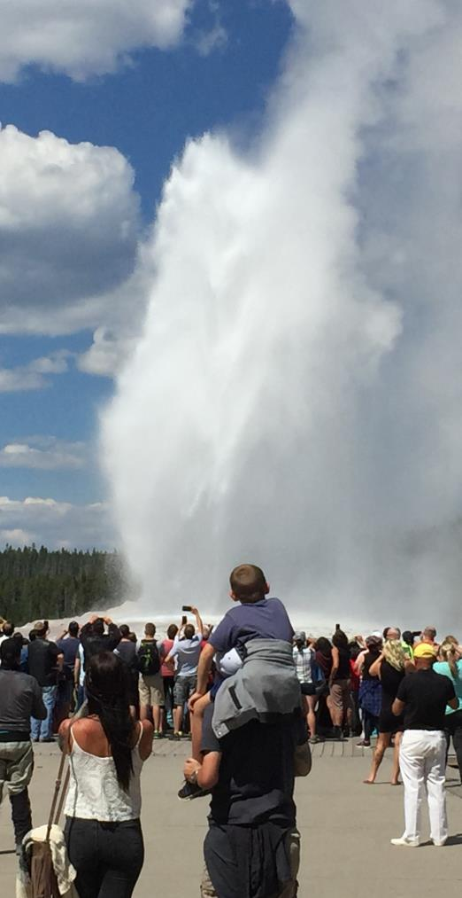
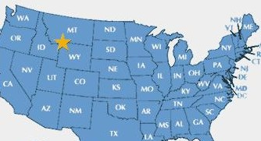
Old Faithful
This is the most famous geyser in the world.
It erupts to a height up to 50 m with eruptions lasting for 2-3 minutes.
The average interval between eruptions is 70 minutes.

Slide 23
Super Eruptions
These are the products of supervolcanoes and are extremely rare events.
They occur when a large volume of magma rises to shallow depths in the continental crust over a hot spot
The magma is originally unable to break through the curst pressure continues to build until the crust can no longer contain it

Slide 24
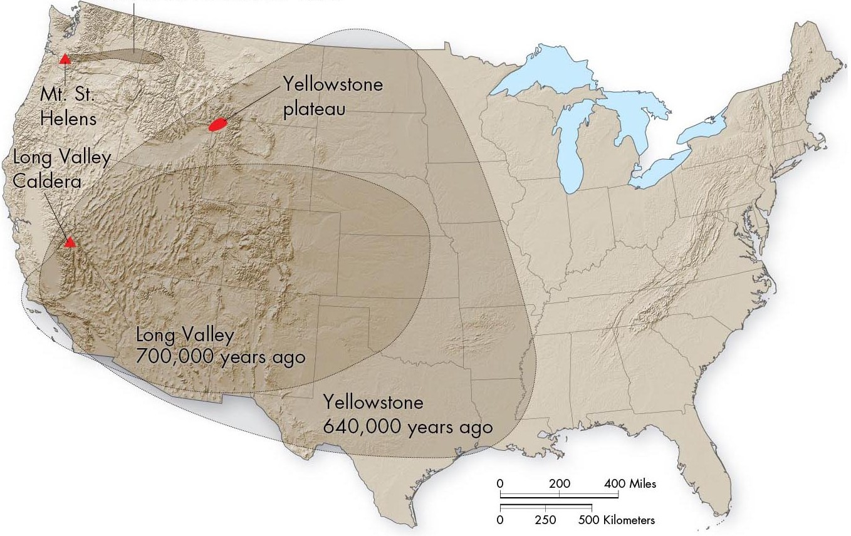
Super Eruptions
A massive amount of land was covered by ash fall from past super eruptions.

Slide 25
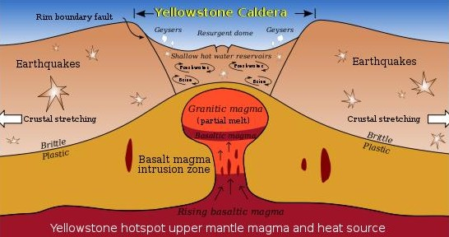
Yellowstone Supervolcano
Yellowstone National Park sits on a massive caldera created from the last eruption of the Yellowstone Supervolcano.
The area is located over a continental hot spot
Super eruptions occurred there 2.2 Mya, 1.3 Mya, and 640,000 years ago

Slide 26
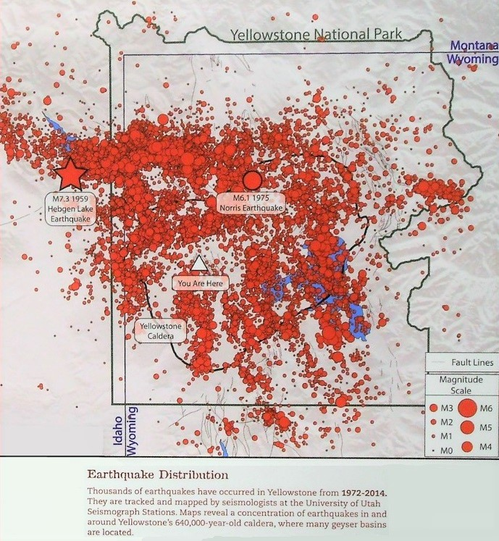
Yellowstone Supervolcano
Earthquakes in the park are monitored continuously.
A super eruption could last
for weeks and spread ash
over half of the U.S.
Ash fall would be over 1000 times that released by
Mt. St. Helens.
Millions of people would die from ash suffocation and the U.S. agriculture economy would be destroyed from a super eruption

Slide 27
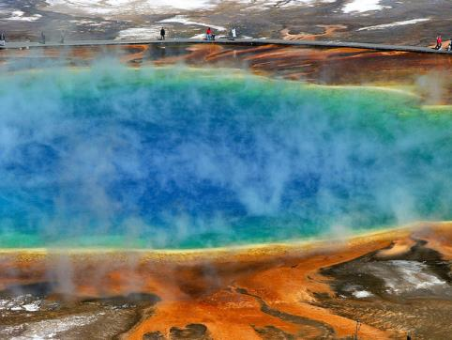
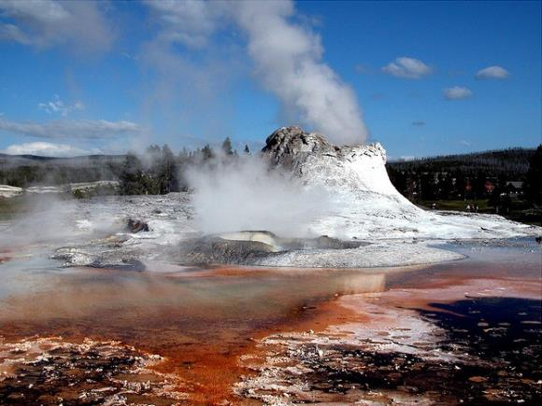
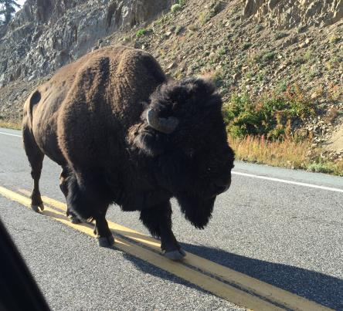
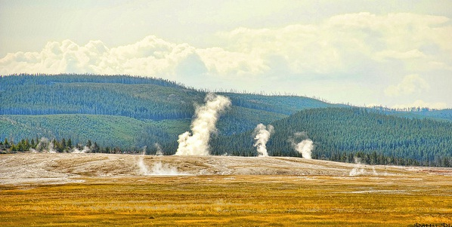
Yellowstone National Park
Along with the hundreds of geysers, the park is home to many species of wildlife.

Slide 28
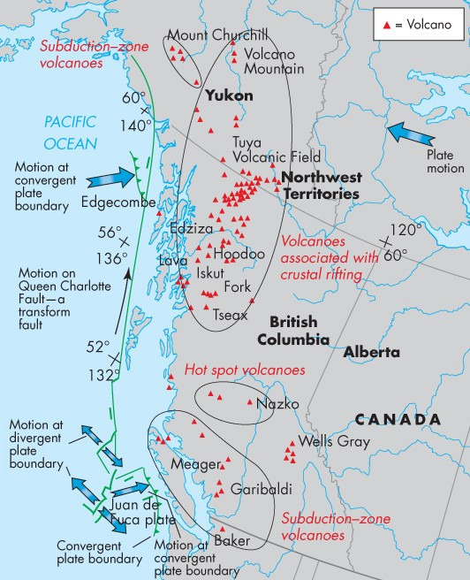
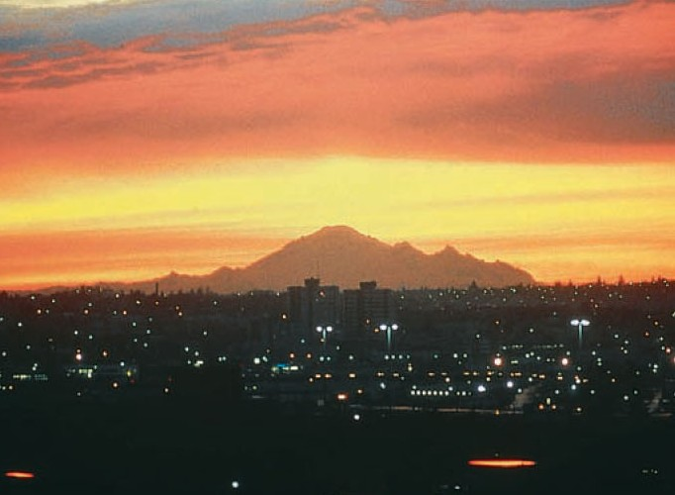
Volcanoes in Canada
They are found only in British Columbia and southern Yukon.
Mt Baker in Wash State provides great risk to Canada

Slide 29
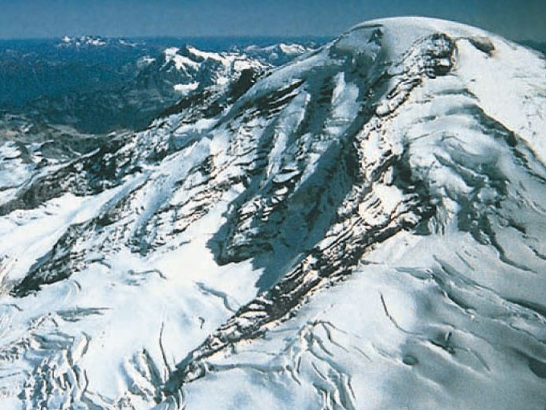
Mt. Baker
An eruption of Mt. Baker would eject large amounts of ash over a densely populated part of British Columbia.
I would also cause landslides and melt glaciers thus causing floods and lahars

Slide 30
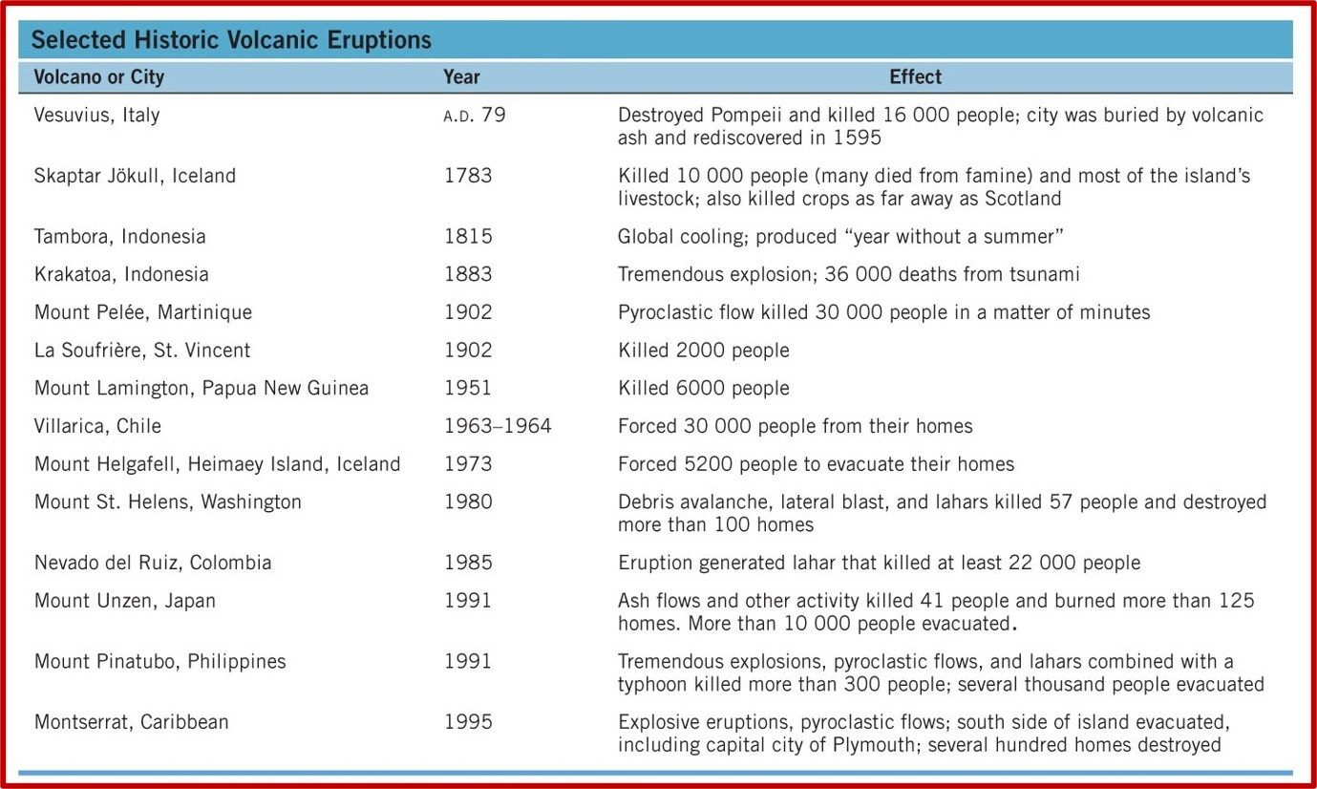
Effects of Volcanoes
On average, 50 to 60 volcanoes erupt each year.
Over the past two centuries, more than 100,000 people have been killed by eruptions

Slide 31
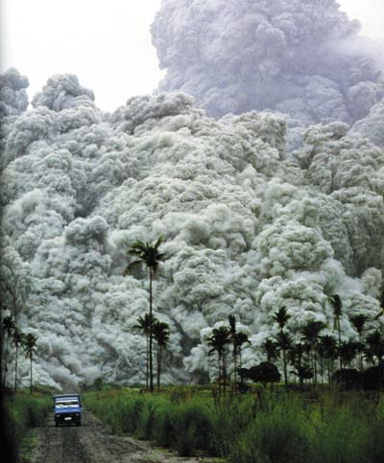
Climatic Effects
Powerful eruptions can impact global climate.
Ash and gases reflect solar radiation causing a cooling

Slide 32
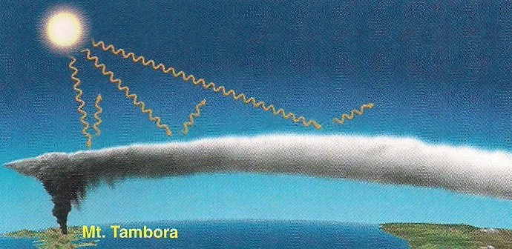
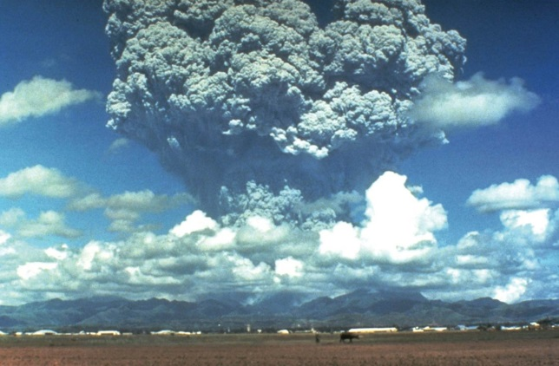
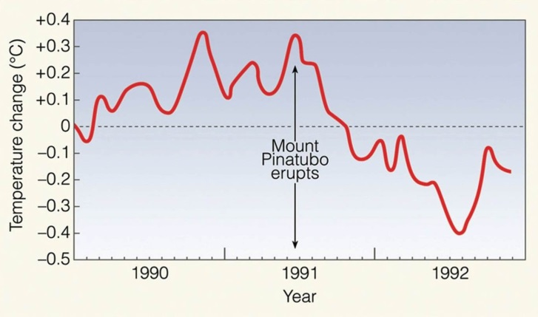
Climatic Effects
Notable eruptions impacting climate:
Mt. Tambora (1815, Indonesia) 1816 is known worldwide as “the year without a summer”
Mt. Pinatubo (1991, Philippines 1992 was one of the coolest years worldwide in the 20th century

Slide 33
Lava Flows
These occur when magma flows out of a central crater or a fissure along the side of a volcano.
Pahoehoe basaltic lava:
Low viscosity (a few km per hour), high temperature, when hardened, it has a smooth texture
Aa basaltic lava:
High viscosity (a few meters per day), lower temp. When hardened, it has a blocky texture

Slide 34
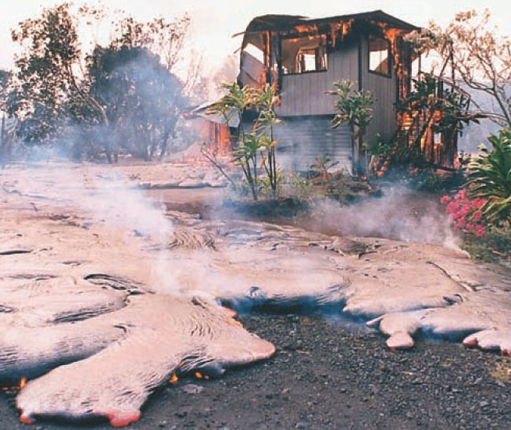
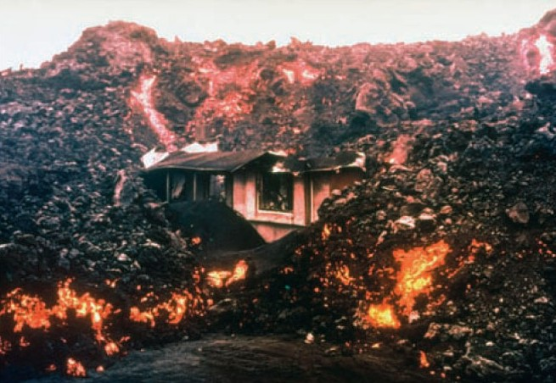
Lava Flows
Aa Lava
Pahoehoe Lava

Slide 35
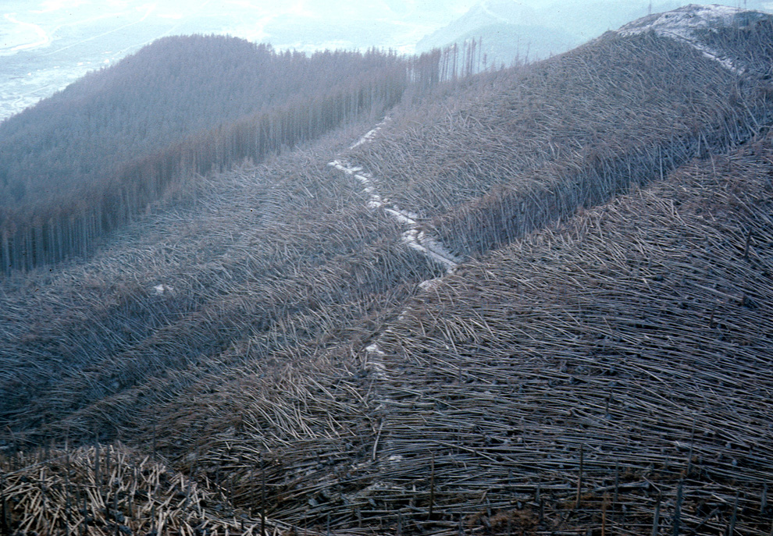
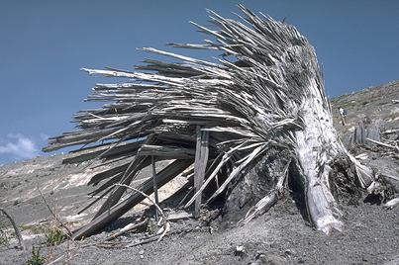
Lateral Blast
Definition:
An eruption directed away from a volcano where materials are blown parallel to the surface.
Example:
A lateral blast from Mt. St. Helens flattened forests for over 20km

Slide 36
Pyroclastic Flow
Definition:
An avalanche of ash, gas, and rock fragments that travels down the slopes of a volcano during an explosive eruption.
Speeds can reach 150km/h and the flow can travel up to 30km from the source
More people have been killed by pyroclastic flows
Than any other volcanic phenomenon

Slide 37
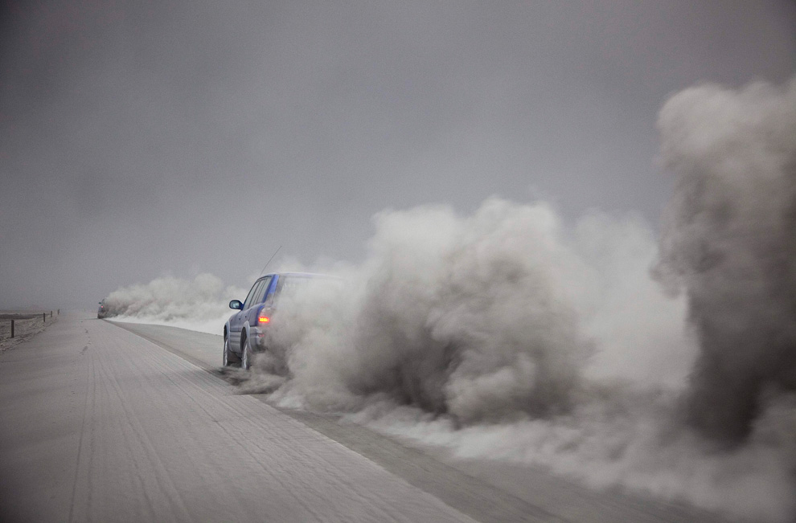
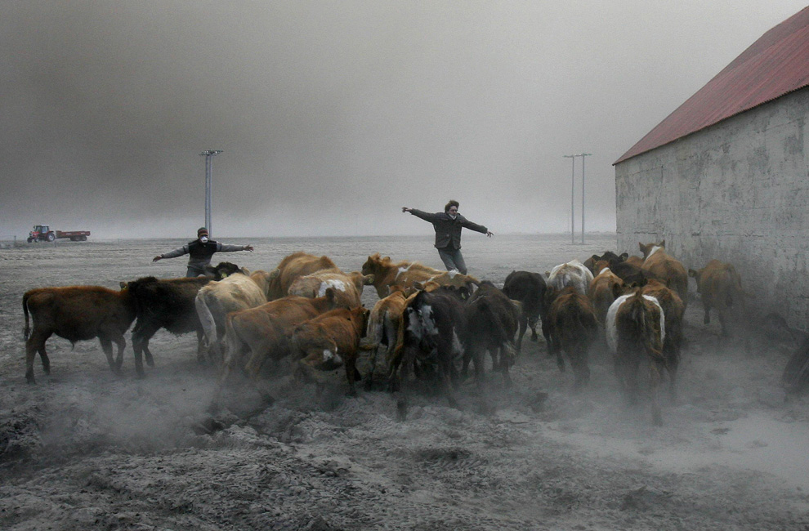
Ash Fall
Particles of ash can be carried downwind hundreds of kilometres from an eruption site.
Hazards of ash fall:
Destroys vegetation
Contaminates surface water
Health impacts to people and animals
Causes aircraft engine failure

Slide 38
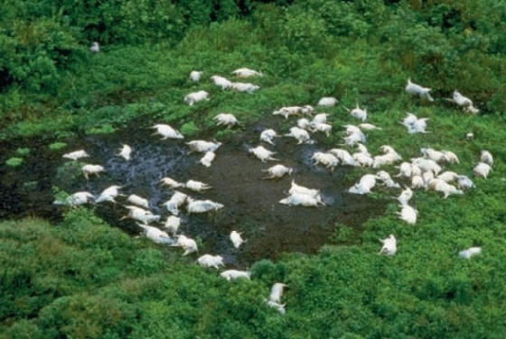
Poisonous Gases
Volcanoes emit numerous gases at high quantities.
Eruptions containing sulphur dioxide can burn holes in leaves and lead to the formation of acid precipitation.
A type of smog known as vog can be produced; this may induce asthma attacks and respiratory problems.
High amounts of carbon dioxide released at once can kill animals and vegetation.

Slide 39
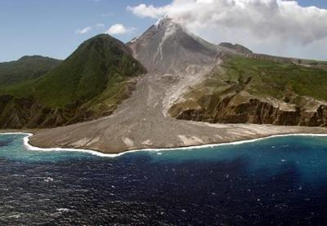
Sector Collapse
The flank of a volcano can collapse at any time.
As magma travels up an inner channel, the volcano can form a bulge where its slopes have become over-steepened

Slide 40
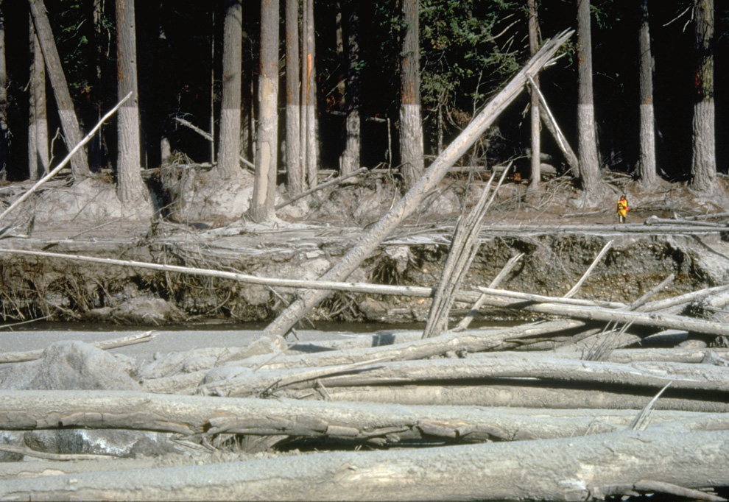
Lahar
Definition:
A large amount of material that has become saturated with water and moves downslope. It is an Indonesian word.
Lahars are also referred to as mudflows

Slide 41
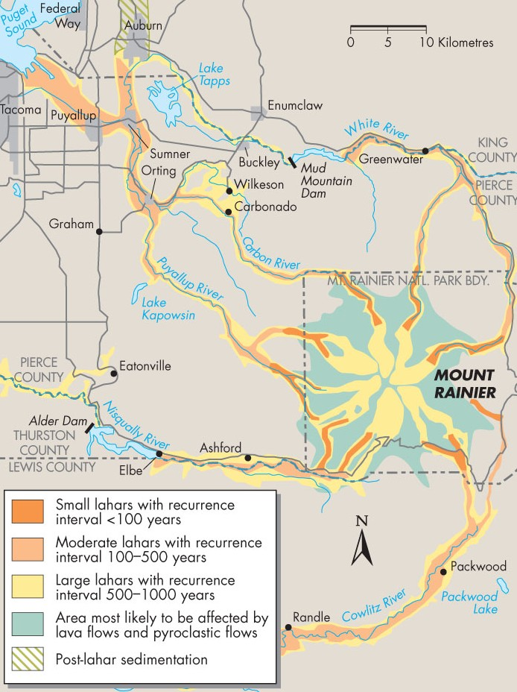
Lahars
Knowledge of local topography and the history of past events can aid in determining the recurrence intervals of lahars.

Slide 42
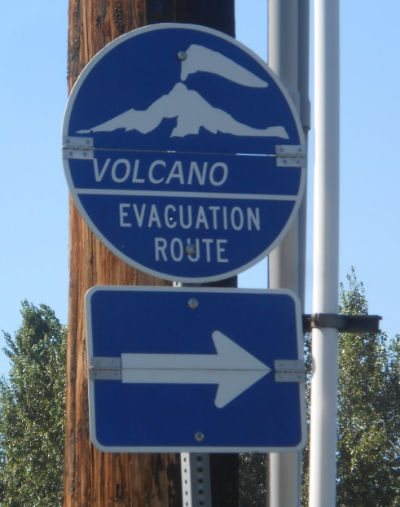

Mt. St. Helens
Before its eruption, the volcano had been dormant for 120 years.
In March 1980 small explosions occurred due to groundwater contacting magma
A bulge began growing on the flank of the mountain.

Slide 43


Mt. St. Helens
On May 18, 1980, a M 5.1 earthquake caused the bulge to break off and fall downslope.
A lateral blast occurred from the area of the former bulge and the entire north slope was destroyed.
Ash was ejected from the central crater, reached heights of 19km, and travelled around the world.

Slide 44

Mt. St. Helens Eruption

Slide 45


Mt. St. Helens Eruption
It killed 57 people, mainly from pyroclastic flows.

Slide 46


Mt. St. Helens Eruption
The eruption left behind a barren landscape that is slowly reforesting naturally.

Slide 47
Natural Service Functions
Ancient volcanoes provided the gases that now form the atmosphere and sustain life on Earth.
Internal heat from volcanoes can produce renewable geothermal energy.
Volcanic landscapes attract tourism and recreation
Eruptions have created new land (Hawaii, Iceland)

Slide 48
Minimizing the Volcanic Hazard
An eruption forecast is a statement containing the probability that a volcano will erupt within a given timespan.
Forecasts are based on information provided by:
Monitoring seismic activity
Shallow earthquake can preceed eruptions
Short warning times from this information is a concern

Slide 49
Minimizing the Volcanic Hazard
2. Thermal and hydrologic monitoring
- an accumulation of magma changes properties of the rock and soil
Increased heat may melt snow or glaciers above
3. Land surface monitoring
Involves checking for the growth of bulges , swelling and opening of cracks

Slide 50
Minimizing the Volcanic Hazard
4. Monitoring volcanic gas emissions
Increases in carbon dioxide or sulphur dioxide may indicate magma is moving toward the surface
5. Analyzing the local geologic history
- mapping of volcanic rocks
Dating of pyroclastic deposits

